Slide 1
AdapterSoup: Weight Averaging to Improve Generalization of Pretrained Language Models
NAME-Sushana Islam Mim
ID- 22273001
CSE713

Slide 2
INTRODUCTION:
To adapt to new domains, large machine learning models (LMs) need constant training.Massive corpora are used to train pre-trained language models (PLMs), although they frequently need to be specialized for certain domains. An method called AdapterSoup ensembles adapters in the weight space to boost performance without updating parameters. Competitive in-domain scores are obtained by combining high learning rates with averaging models with low learning rates.

Slide 3
RELATED WORKS:
Training large models from scratch has severe computational and environmental costs.
Efficient methods such as mixtures-of-experts (MoE), adapters, and LoRA layers have been proposed for domain adaptation.
Averaging weights of models independently finetuned on the same task has shown to improve in-domain performance.
(2022) fine-tune MoEs using adapters on a downstream task and average their weights at test time.
This paper focuses on improving test-time scores of a model on novel domains.

Slide 4
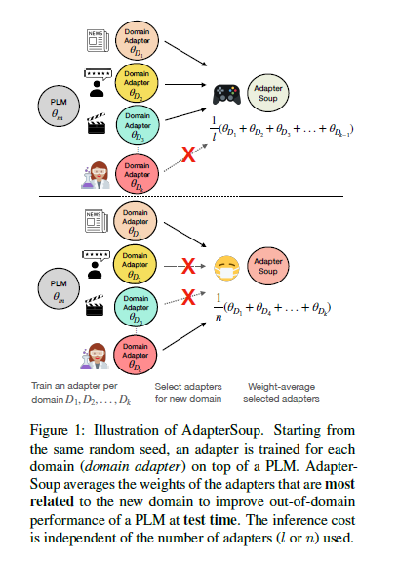
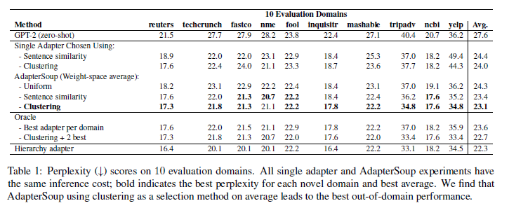
Evaluation domains
Adapter soup illustration

Slide 5
Proposed approach:
Cross-Domain AdapterSoup : We only finetune the adapters, without updating the parameters θm of the PLM, for language modeling using cross-entropy loss.
Let us assume that θ = FineTune(θm, θα, φ, D) denote the parameters obtained by fine-tuning a PLM with adapters in a domain D, using hyper-parameters φ.

Slide 6
Proposed approach:
Single-Domain AdapterSoup: This is similar to logit ensembling, but only adds to the PLM the inference cost of a single adapter, while the added inference cost of logit ensembling scales linearly with the number of adapters

Slide 7
Proposed approach:
Model Selection for AdapterSoup: In this section we describe two methods for selecting the combination of models to create our AdapterSoup (by weight-space averaging) which will be evaluated on a novel domain Dk+1.
We add up to 5 adapters to the AdapterSoup in order of highest cosine similarity (only considering models

Slide 8
Result:
Cross-domain:
This is an evaluation of how well these two approaches measure similarity between the novel domain Dk+1 and the training domains; this baseline shows the performance of a single model which can be directlycompared to AdapterSoups.
Both approaches are significantly better than GPT-2 (zero-shot), and Clustering outperforms Sentence similarity, suggesting it is better at identifying related domains.
All three are equally as efficient at inference as using a single adapter.

Slide 9
Result:
Single-domain: The number of updates for each adapter is the same, and they all have the same initialization, so we hypothesize that AdapterSoups made from small learning rates act similarly to averaging across steps in gradient descent, leading to a model that is closer to a local optimum.

Slide 10
LIMITATION:
The conclusions we draw in this work about how our approach compares to other approaches (e.g., our baselines) are only supported by evidence onthe task of language modeling, with textual domains taken from the C4 dataset.

Slide 11
CONCLUSION:
A text clustering technique enhances PLM performance in new domains by selecting adapters and weight-space averaging them without changing parameters or increasing inference cost. Future research should explore more complex selection techniques.

